Slide 1
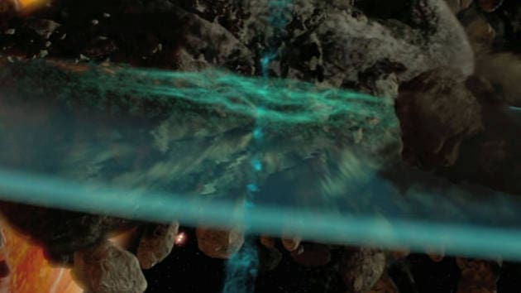
Star wars TM seismic charge CGP SHADER MINI-PROJECT
Tonko Bossen
Aalborg University, Medialogi 5
2. dec. 2022
Notes:
https://www.starwars.com/video/seismic-charges

Slide 2
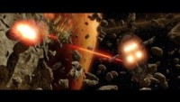

Slide 3
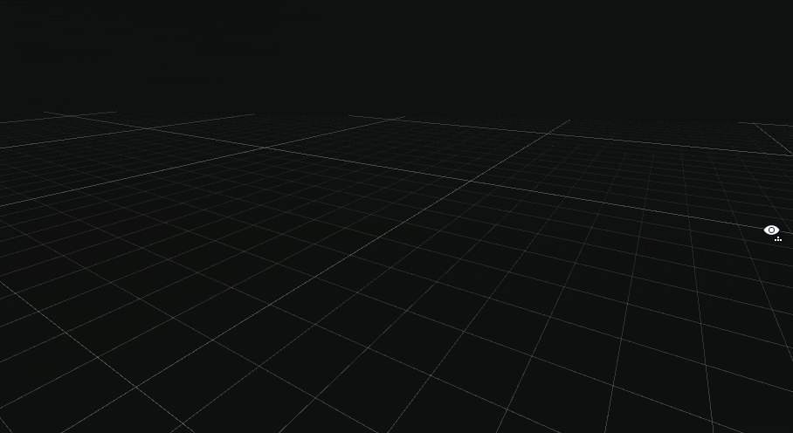

Slide 4


Slide 6
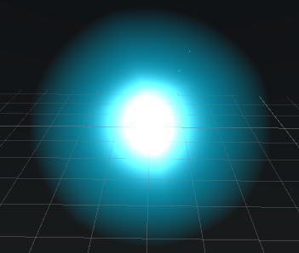
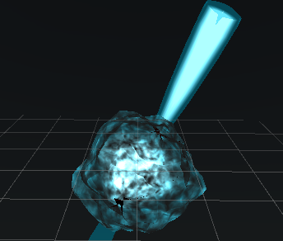
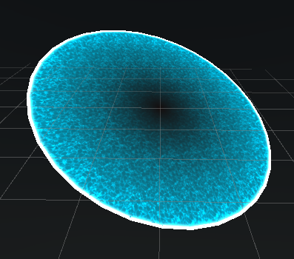
Elements
Bloom glint
Smoke & cones wind-up
Disc expanding

Slide 7
Bloom glint

Slide 8
Smoke & cones wind-up

Slide 9
Disc expanding

Slide 11
Fixed UV scaling

Slide 12
Cones vertex distortion

Slide 13
Distance

Slide 14
Fresnel

